Slide 1
Are stethoscopes a potential vector of infection transmission at Broome Hospital?

Slide 2
Reason for audit
Within health care there are clear guidelines on hand washing but we are not aware of guidance for other potential vectors of infection transmission including stethoscopes
Generally, stethoscopes are used by both medical and nursing staff on a daily basis on multiple different patients.
Discussion with colleagues in Broome Hospital revealed that stethoscope cleaning was not regular practise
Community acquired MRSA and tropical infections are present in the Kimberley

Slide 3
Burden of healthcare associated infections (HAIs)
• World-wide prevalence survey of healthcare associated infections (55 hospitals,
14 countries).
- Overall average 8.7% of all admissions affected by HAIs.
- Cost 5-10% of healthcare budgets (UK £1billion, US $4.5 billion)
(World Health Organization, 2005)
• Australia 200,000 healthcare-associated infections (HAIs) in acute facilities every
year - most common complication affecting patients in hospital.
(Australian Commission for Safety and Quality in Health Care, 2010)

Slide 4
Literature Review: Can stethoscopes be a vector for cross contamination?
Pubmed/Medline search
“stethoscope”, “infection control”, “nosocomial”, “vector”,
“cross-infection”, “contamination” and “disinfection”
‘Infection hazards of Stethoscopes in Hospitals’
(Gerkin et al, Lancet, London, 1972)

Slide 5
Literature Review: Can stethoscopes be a vector for cross contamination?
Identified 36 studies examining stethoscopes as source of HAIs. Examples:
1992. ‘Stethoscopes as possible vectors of infection by staphylococci.
(Breathnach et al, British Medical Journal)
1997. The stethoscope: a potential source of nosocomial infection ?
(Marinella et al, Archive of Internal Medicine )
2000. The stethoscope in the emergency department: a vector of infection?
(Nunez et al. Epidemiology of Infection)
2009. Background contamination of stethescopes in the intensive care unit.
(Whittingham et al. Anaesthesia)
Conclusions: All studies highly positive for colonisation.
Colonisations between 80-90%
Pathogenic average 22% (Staph. aureus, pseudomonas, enterobacter, e. coli)

Slide 6
Literature Review: Does stethoscope contamination lead to infection in the patient ?
11 studies supported the notion that of a causal relationship.
- Rationale: ‘ Common pathogens such as staph aureus, e coli, pseudomonas can
survive a long time on stethoscope membranes.. (examples: staph aureus
(18hrs), RSV (6hrs))
- Much greater risk in immunosompromised, chronic disease patients or when in
contact with mucosa, blood, burns.
(Neely et al, Journal of Clinical Microbiology. Feb, 2000)
(Lecat et al, American Journal of Infection Control. April, 2009)
(Whittingham et al., Anaesthesia. Dec, 2009)
Highly suggestive that stethoscopes are a possible vector and also an ideal and easy target for intervention alongside hand-washing.

Slide 7
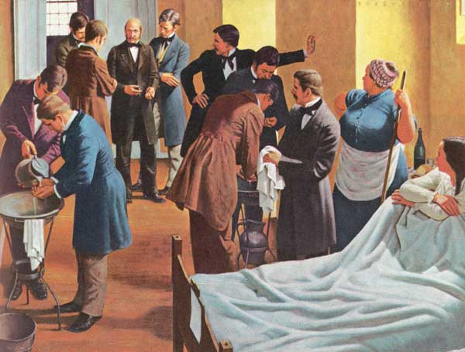
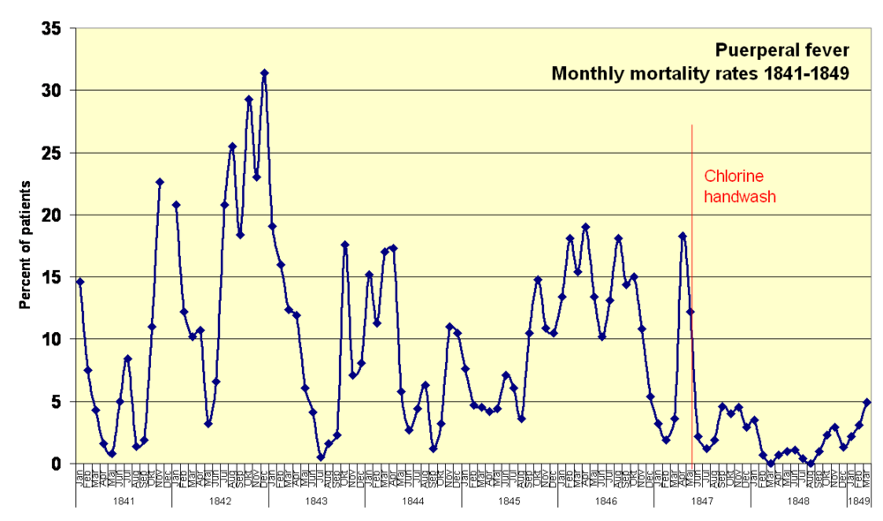
Simple measures can have big impact
• 1860 Hungary, puerperal sepsis 30% to <2%.
Ignaz Semmelweis showed simple handwashing in a chlorinated-lime solution
Before attending the labour ward was an effective intervention
Largely ostracized by his colleagues, eventually went mad!

Slide 8
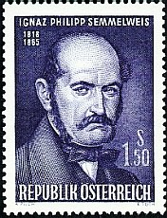
Simple measures can have big impact
• 1860 Hungary, puerperal sepsis 30% to <2%.
• ‘70% nosocomial infections can be prevented with adherence to effective infection control, such as hand washing and stethoscope cleaning ‘
(Schabrun et al, Journal of Hospital Infection, March, 2006)

Slide 9
Standards: How often to clean?
Stethoscopes considered care equipment (same as thermometer, drip stands and so on)
Gold Standard is to clean daily and after each patient.
Australian Commission for Safety and Quality in Health Care (2010)
‘Clean when visibly dirty, when blood, and between patients ..’
WHO / National Institute of Clinical Excellence:

Slide 10
Standards: How to keep your stethoscope clean.
Antimicrobial stethoscope covers?
(Wood et al, American Journal of Infection Control. May, 2007)
Antiseptic soap 83% reduction in colony forming units
Ethyl Alcohol (ethanol) 93.2% reduction
Propyl alcohol (disinfecting pad) 96% reduction
(Schroeder et al, Journal of Family Practice. August, 2009)
(Jones et al, Annals of Emergency Medicine. September, 1995)

Slide 11
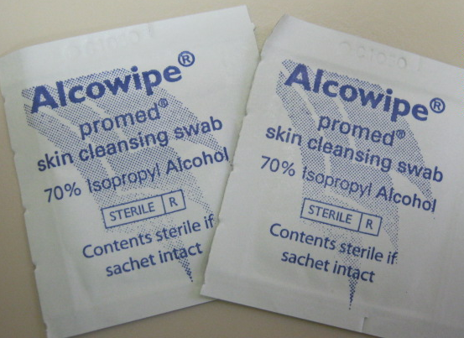
Standards: Broome Hospital
‘The Gold Standard is to clean stethoscopes after contact with each patient using Promed antibacterial wipes (70% isopropyl).. alongside mobile phones, pagers and handwashing**.’
Broome Hospital Infection Control and Regional Infection Control Advisory Group.

Slide 12
Aims
Identify if pathogenic bacteria are present on stethoscopes within Broome Hospital?
Identify health care professionals current stethoscope cleaning practise in Broome Hospital
Does cleaning Stethoscopes reduce colonisation rates?
Is there any difference between occupation and location for rates of colonisation with pathogenic bacteria in Broome Hospital?

Slide 13
Methodology
30 staff members Stethoscopes were selected at random from the following clinical areas of Broome Hospital on the 9th September 2013 for 14:00-16:00:
Emergency Department
General Ward
Paediatric Ward
Theatres
Maternity unit
Each staff member was asked to complete a brief questionnaire on their current stethoscope cleaning practise
The diaphragm of each stethoscope was swabbed for 10 seconds with a charcoal swab
The swabs were processed by the Pathwest laboratory in Perth where the bacterial growth was measured as mild, moderate or abundant.
All questionnaires and swabs were anonymised

Slide 14
Questionnaire
Candidate number ………………..
Location ………………..
Occupation ………………..
How often do you clean your stethoscope?
Per Patient | Daily | Weekly | Monthly | 6 Monthly | Not Done
How often do you think it should be cleaned?
Per Patient | Daily | Weekly | Monthly | 6 Monthly | Not Done
What do you clean your stethoscope with?
Do you know where to find guidelines on infection control?
What would make you clean your stethoscope?

Slide 15
Questionnaire Results

Slide 16
There is a significant discrepancy between current practise and perceived clinical need.
20% of healthcare professionals indicate they are cleaning between every patient
80% believe that they should be cleaning there stethoscope between every patient

Slide 17
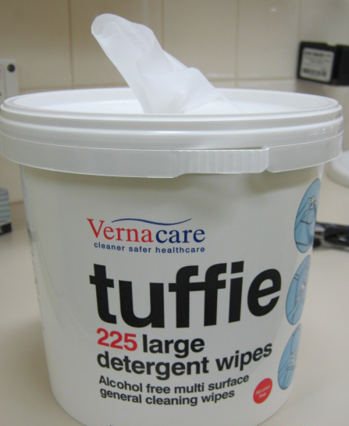
What do you clean your stethoscope with?
Alcohol wipes or Tuffie wipes.
Do you know where to find guidelines on infection control?
12 answered No
18 answered yes; the intranet.
(No specific location was known).

Slide 18
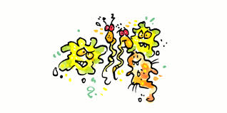
What would make you clean your stethoscope?
(Most Common)
Dirty Patient
Bodily Fluids
Visible dirt
Skin Infections
Factual evidence about infection transmission via equipment
High infection risk patient
Sick Patient
Accessibility of wipes
Other users of stethoscope
Constant reminder messages – Posters

Slide 19
Stethoscope swab results
24 out of 30 stethoscopes were colonised with bacteria
Only 6 clean stethoscopes!!
49 bacteria in total were identified off the 24 dirty stethoscopes
There was no difference in results according to staff location or occupation

Slide 21
Type of Bacteria | Number Identified on all stethoscopes
Micrococcus Luteus | 13
Moraxella | 7
Staphylococcus Hominis | 7
Staphylococcus Epidermidis | 6
Acinetobacter | 5
Pseudomonas Stutzeri | 5
Staphylococcus Lugdunensis | 1
Staphylococcus Capitis | 1
Arthrobacter | 1
Bacillus | 1
Brevundimonas | 1
Rhodococcus | 1
Total Bacteria | 49
No MRSA identified!

Slide 22
Type of Growth | Number of Bacteria
Scanty | 36
Moderate | 9
Abundant | 4

Slide 23
Discussion with Broome laboratory staff and Royal Perth Hospital Microbiologist highlighted the following as potential PATHOGENIC bacteria:
Acinetobacter
Micrococcus Luteus
Pseudomonas
Moraxella
All 4 Staphylococcus
This accounted for 90% of all the bacteria identified
Many of Broome Hospital patients suffer from chronic diseases which makes them more susceptible to these bacteria

Slide 24
Conclusion
80% of stethoscopes were colonised with bacteria
90% of bacteria were pathogenic
There is a significant discrepancy between current cleaning practise and what staff believe should be the standard of cleaning.
Staff clean stethoscopes most commonly due to; visible dirt, bodily fluids and dirty patients

Slide 25
Recommendations
Clean stethoscopes before and after each patient contact
Clean stethoscope with Promed wipes (70% isopropyl)
Presentation of Audit results to staff members
Dissemination of audit results to hospital staff via Webmail
Education posters to be put up in clinical areas
Repeat audit to evaluate if change in practise has occurred

Slide 26
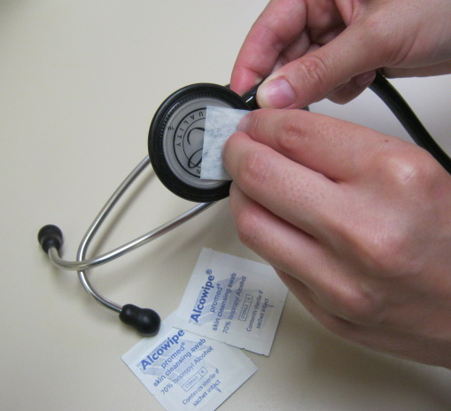
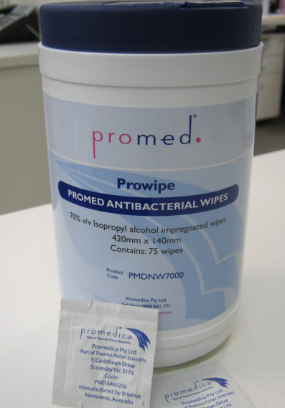
ARE YOU CLEANING
YOURS ?!
Stethoscopes should be cleaned between every patient alongside
hand-washing protocol

Slide 27
References
Bandi S, Conway L. Does regular cleaning of stethoscopes result in a reduction in nosocomial infections? Archive of Disease in Childhood, June 2012.
Breathnach AS, Jenkins DR, Pedler S. Stethoscopes as possible vectors of infection by staphylococci. British Medical Journal, 1992.
Cohen HA, et al . Stethoscopes and otoscopes—a potential vector of infection? Family Practitioner April, 1997.
Fenelon L, Holcroft L, Waters N. Contamination of stethoscopes with MRSA and current disinfection practices. Journal of Hosp Infection. April 2009.
Ferguson JK. Preventing Healthcare associated infections: risks, healthcare systems and behaviour. 2009
Garner TK, Rimland E. Stethoscopes and infection. JAMA 1982.
Gerken A, Cavanagh S, Winner HI. Infection hazard from stethoscopes in hospital. Lancet. June, 1972.

Slide 28
References
Hill C, King T, Day R. A strategy to reduce MRSA colonization of stethoscopes. Journal of Hospital Infection. January, 2006.
Hudson H. Stethoscopes and infection control: a study into the use of stethoscopes in a paediatric ward and their possible contamination. Journal of Child Health Care. June 2003.
Jones JS, Hoerle D, Riekse R. Stethoscopes: a potential vector of infection? Annals of Emergency Medicine. September, 1995.
Lecat et al. Ethanol-based cleanser versus isopropyl alcohol to decontaminate stethoscopes. Journal of Infection Control. April, 2009.
London PS. Infection from stethoscopes in hospital. Lancet. June 1972.
Mangi RJ, Andriolc VT. Contaminated stethoscopes: a potential source of nosocomial infections. Yale Journal of Biological Medicine, 1972.
Neely AN, Maley MP. Survival of enterococci and staphylococci on hospital fabrics and plastic. Journal of Clinical Microbiology. 2000 Feb.

Slide 29
References
Nunez S, Moreno A, Green k et al. The stethoscope in the emergency department: a vector of infection? Epidemiology of Infection. 2000.
NHMRC. Australian Guidelines for the Prevention and Control of Infection in Healthcare. Commonwealth of Australia. Australian Commission for Safety and Quality in Health Care (2010)
Marinella MA, Pierson C, Chenoweth C. The stethoscope: a potential source of nosocomial infection? Archive of Internal Medicine, 1997.
Merlin MA, Wong ML, Pryor PW, et al. Prevalence of methicillin-resistant Staphylococcus aureus on the stethoscopes of emergency medical services providers. Prehosp Emergency Care. Jan-Mar 2009.
Parmar RC, Valvi CC, Sira P, et al. A prospective, randomized, double-blind study of comparative efficacy of immediate versus daily cleaning of stethoscope using 66% ethyl alcohol. Indian Journal of Medical Science. 2004.
Redington JJ, et al. The stethoscope a forgotten MRSA fomite? Paper presented at the ICAAC; Anaheim, CA; October 11-14, 1992..

Slide 30
References
Rutala WA, Weber DJ. Disinfection and sterilization in health care facilities: what clinicians need to know. Clinical Infectious Diseases. September, 2004.
Sanders S. The stethoscope and cross-infection revisited. British Journal of General Practice. January 2005.
Saunders et al. Factors influencing stethoscope cleanliness among clinical medical students. Journal of Hospital Medicine, June, 2013.
Schabrun S, Chipchase L. Healthcare equipment as a source of nosocomial infection. Journal of Hospital Infection. March, 2006.
Schroeder MA, D’Amico F. What’s growing on your stethoscope (and what you can do about it) Journal of Family Practice. August, 2009.
Sood P, Mishra B, Mandal A. Potential infection hazards of stethoscopes. J Indian Med Assoc. Jul 2000;98(7):368-370.
Smith MA, Mathewson JJ, Ulert A, Scerpella EG, Ericsson CD. Contaminated stethoscopes revisited. Arch Intern Med 1996;156:82-84.

Slide 31
References
Thofern UA. Bacterial contamination of hospital physicians' stethoscopes. Infection Control in Hospital Epidemiology. September, 2000.
Uneke CJ, et al. Bacteriological assessment of stethoscopes used by medical students in Nigeria: implications for nosocomial infection control. World Health Population. 2008.
Varghese D, Patel H. Hand washing. Stethoscopes and white coats are sources of nosocomial infection. British Medical Journal. August ,1999.
Whittingham AM, Whitlow G, Hewson D et al. Background contamination of stethoscopes in the intensive care unit. Anaesthesia. December, 2009..
World Health Organization. WHO guidelines on hand hygiene in health care: a summary. Geneva, World Health Organization, 2005.
Wood MW, Lund RC, Stevenson KB. Bacterial contamination of stethoscopes with antimicrobial diaphragm covers. American Journal of Infection Control. May, 2007.
Wright IM, Orr H, Porter C. Stethoscope contamination in the neonatal intensive care unit. Journal of Hospital Infection. January, 1995.

